Slide 1

Security Evaluation of Encrypted Databases (SEEDv1.0)
Team Members: Steven Caceres, Joannier Pinales Product Owner: Mark Finlayson
Instructor: Masoud Sadjadi School of Computing and Information Sciences Florida International University
Final Presentation
Spring 2018
Notes:
7 seconds.( I will select 2 best slides (i will give them extra points and students will present for CIS committee)
Greet your audience, thank them for attending your presentation, introduce yourself, introduce your project, introduce your team members, and quickly indicate what each of you did in a high-level manner, and put more emphasis on your part/contribution.

Slide 2
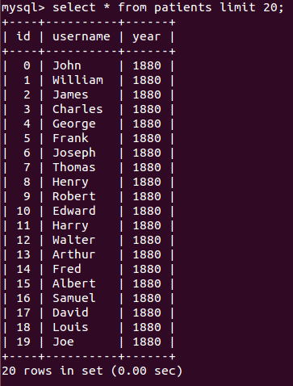
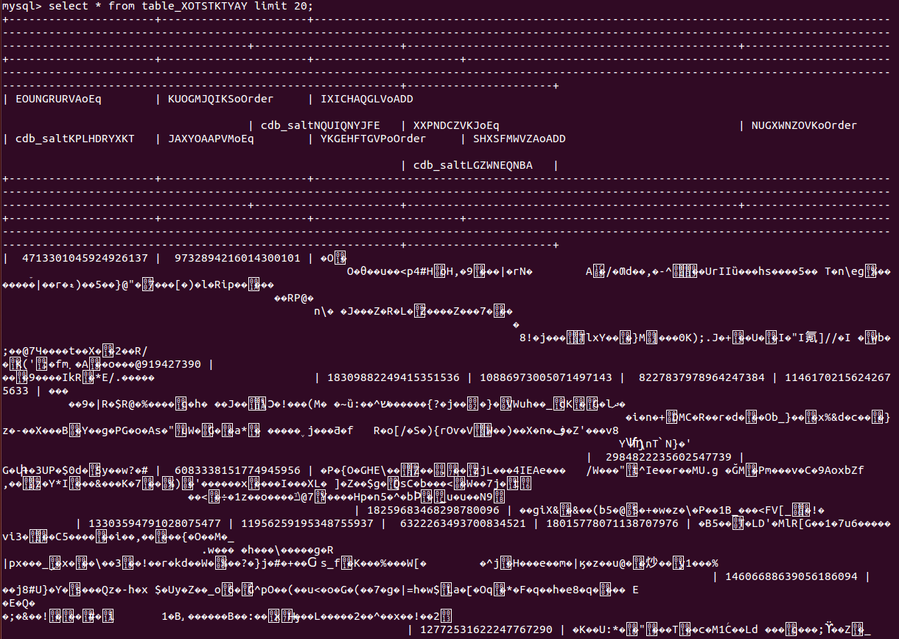
Our Data Should Be More Secure
As everything continues to shift online, we see an increasing amount of vital information being stored in the cloud. If recent events have shown us anything, it’s that this information needs to be kept more securely.
Plain text Encrypted data
Notes:
10 seconds.
Introduce the problem that the whole project (in all versions) tackles with GIF or screenshot.

Slide 3
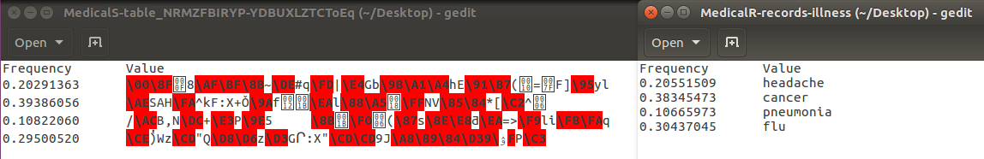
Improving Encrypted Databases
Although encrypted databases increase security, they can still accidentally leak information.
By attacking columns with deterministic encryption, it is possible to infer the values by comparing their frequencies with an auxiliary set
Notes:
20 seconds.
Introduce the problem that the your project (in new version) tackles with GIF or screenshot.

Slide 4

Improving Encrypted Databases
To solve this data leak in the system, we need to smooth the frequency of data within the database
Have fake data included server-side, but omit it from the result set
Frequency analysis cannot be done on flat distributions
Notes:
20 seconds.
Introduce the problem that the your project (in new version) tackles with GIF or screenshot.

Slide 5
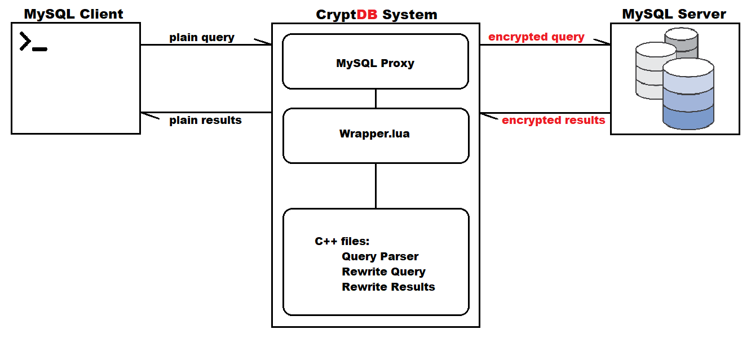
Simplified System Design
Notes:
5 seconds
Show the Use Case Diagram for the whole project. Highlight your use cases.

Slide 6
System Design: Architecture
Implementation is done within wrapper.lua since it has access to the plaintext query, and the result set
Before a query is sent to the database by the proxy, the query is parsed, frequencies of data are updated, and the query is altered if it is creating a table
After the database returns the result set to the proxy, it is altered to remove any fake rows, and the fake column
Once the result set has been scrubbed of any fake data, it is passed to the client application to display
Notes:
20 seconds
System design: Highlight the parts that you contributed to them.
1. System decomposition; identify the architecture patterns used
2. System deployment – h/w and s/w requirements

Slide 7
User Stories
Filter out fake rows form the result set
Calculate the frequency distribution of a column
Run a frequency attack on the system
Omit the fake column from the result set
Create a basic web app for CryptDB
Notes:
5 seconds.
List the user stories that you worked on them.(put in order of importance). Stay focused on the parts that you have been working.

Slide 8
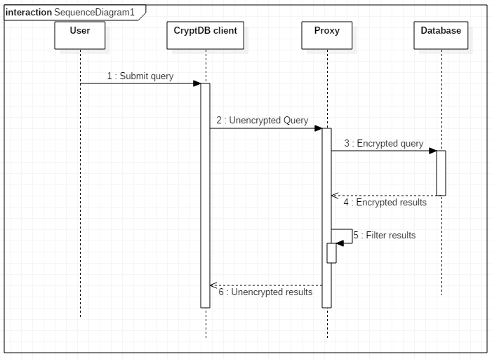
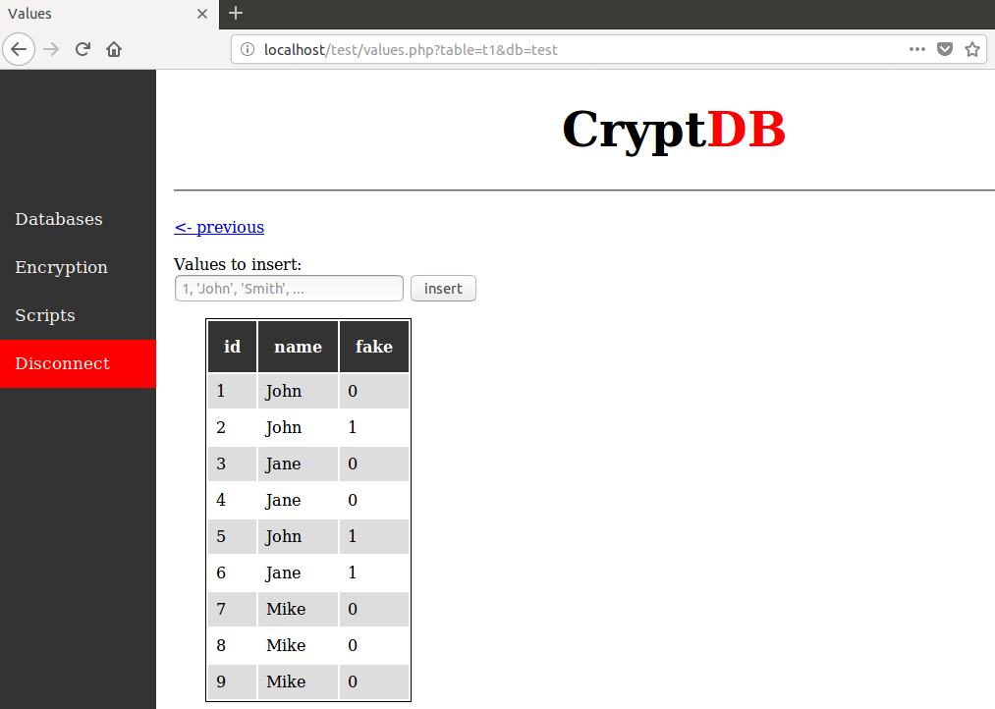
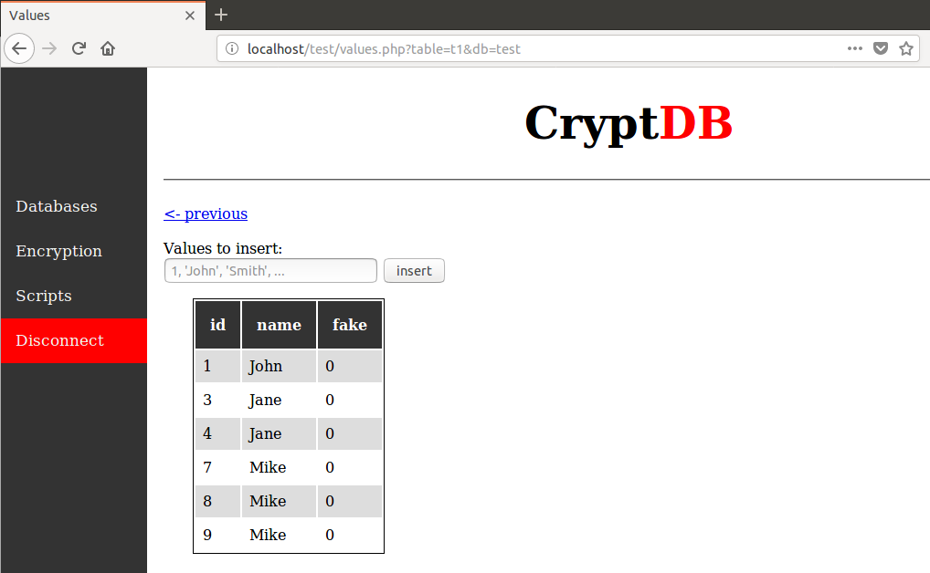
Filter out fake rows from result
The result set is filtered by looping through the rows and removing any
row that has a value of 1 in it’s fake column. It’s important to scrub the
results in the proxy, so that the fake column maintains it’s encryption.
All data that is stored in the server The results passed to the user
Notes:
20 seconds
The tile of user story
Please present and show the complexity of your work, code, algorithms, and technical challenges and technologies you have used. (you could use screenshot if you want. Visual presentations are better than text presentation) - Go into the details of the most important/significant tasks using bullet lists or visual graphs or state chart diagram - Demo using screenshots or GIF (in another separate page if required)
Sequence Diagram for this user story is optional

Slide 9
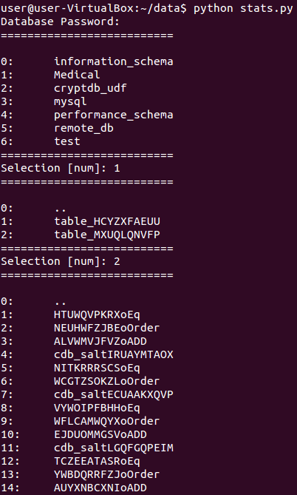
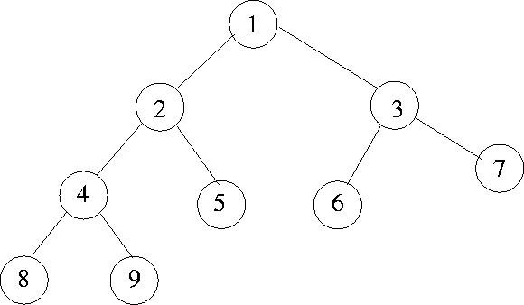
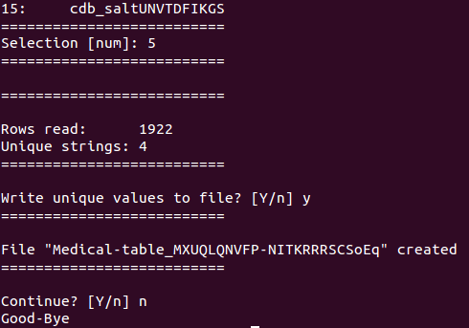
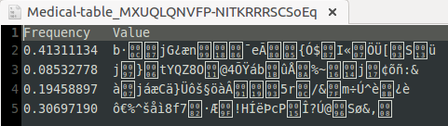
Calculate the frequency distribution
Notes:
60 seconds
The tile of user story
The most important user story you worked on it. You have to describe this one very well and be proud of that.
Please present and show the complexity of your work, code, algorithms, and technical challenges and technologies you have used. (you could use screenshot if you want. Visual presentations are better than text presentation)
Go into the details of the most important/significant tasks using bullet lists or visual graphs or state chart diagram
Sequence Diagram for this user story is mandatory (in another separate page if required)
Demo using screenshots or GIF (in another separate page if required)

Slide 10
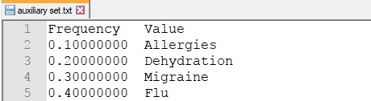
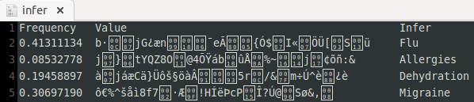
Run frequency attack on system
Notes:
20 seconds
The tile of user story
Please present and show the complexity of your work, code, algorithms, and technical challenges and technologies you have used. (you could use screenshot if you want. Visual presentations are better than text presentation) - Go into the details of the most important/significant tasks using bullet lists or visual graphs or state chart diagram - Demo using screenshots or GIF (in another separate page if required)
Sequence Diagram for this user story is optional

Slide 11
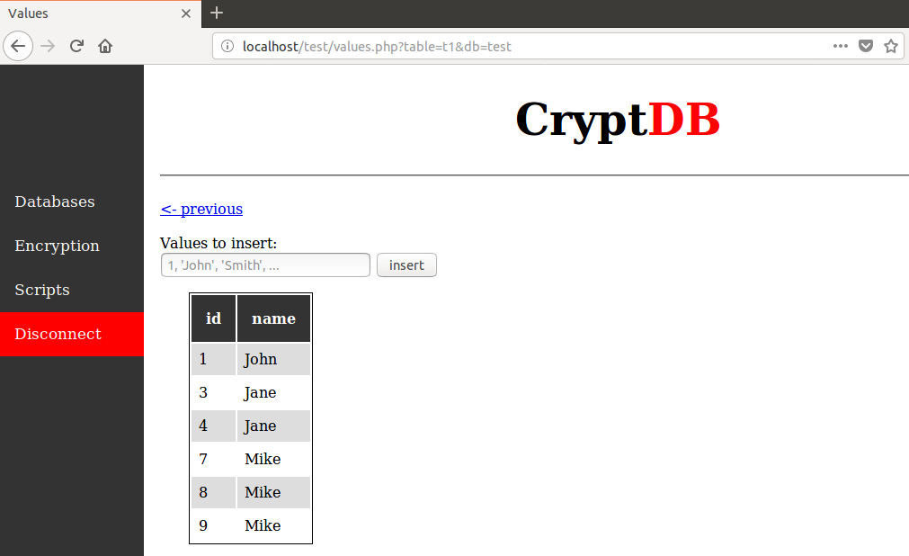
Omit the fake column from result
All data that is stored in the server The results passed to the user
Notes:
20 seconds
The tile of user story
Please present and show the complexity of your work, code, algorithms, and technical challenges and technologies you have used. (you could use screenshot if you want. Visual presentations are better than text presentation) - Go into the details of the most important/significant tasks using bullet lists or visual graphs or state chart diagram - Demo using screenshots or GIF (in another separate page if required)
Sequence Diagram for this user story is optional

Slide 12
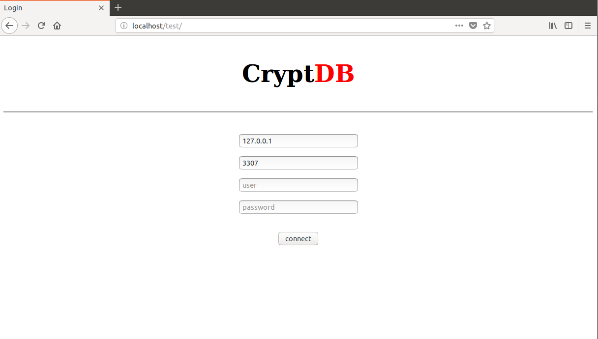
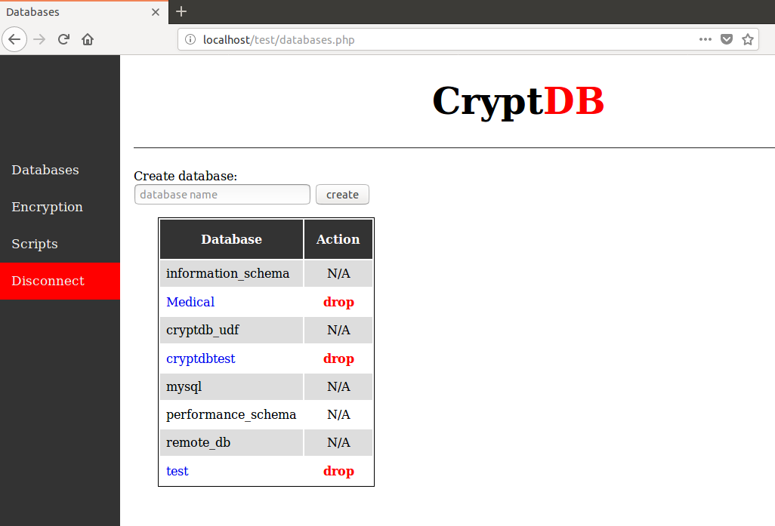
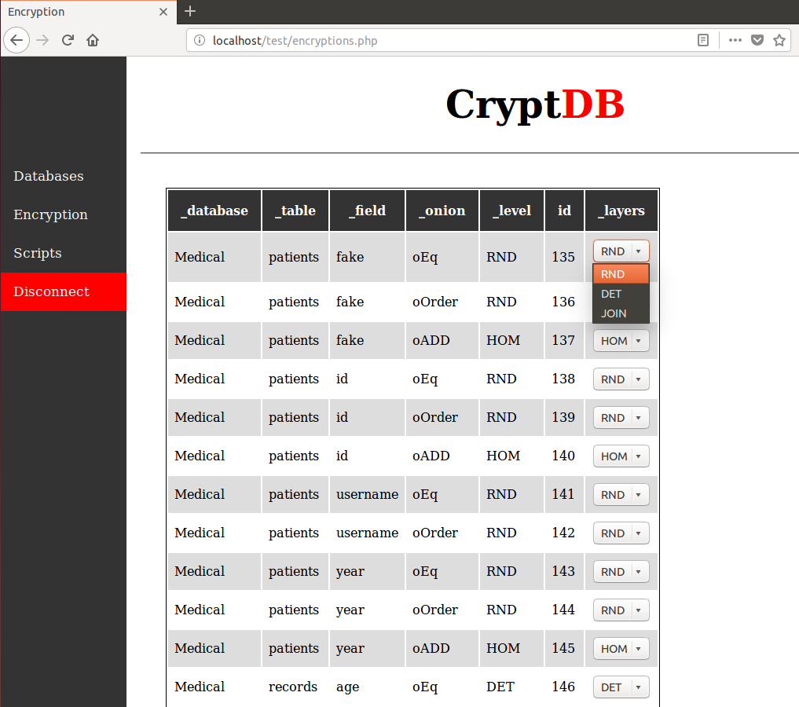
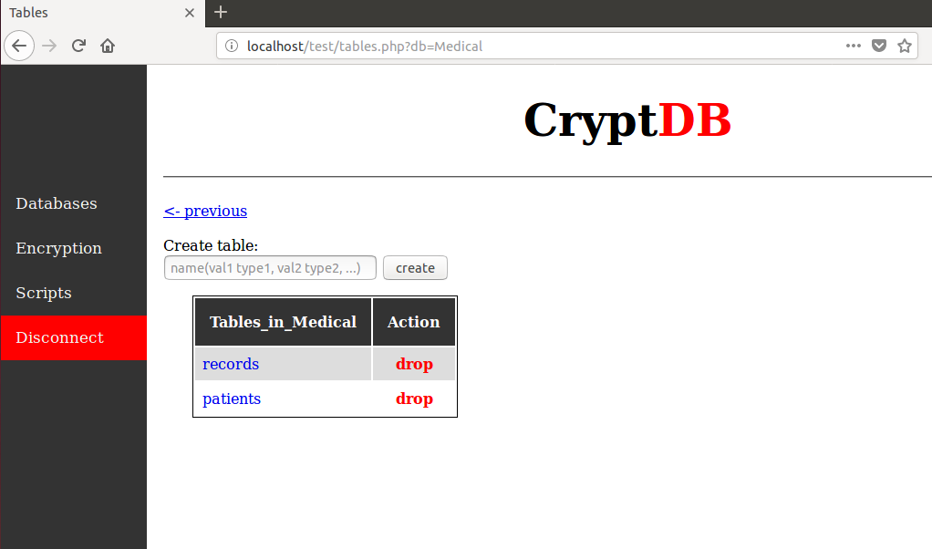
Create a basic web app for CryptDB
Notes:
20 seconds
The tile of user story
Please present and show the complexity of your work, code, algorithms, and technical challenges and technologies you have used. (you could use screenshot if you want. Visual presentations are better than text presentation) - Go into the details of the most important/significant tasks using bullet lists or visual graphs or state chart diagram - Demo using screenshots or GIF (in another separate page if required)
Sequence Diagram for this user story is optional

Slide 13
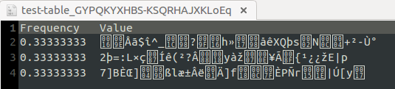
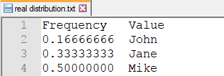
Test Suites and Test Cases
All data on the server Result passed to user
After running frequency analyzer The real distribution of data
Notes:
10 seconds
A description of verification process and Test Suites and Test Cases for one of the use cases.
1 One sunny day and one rainy day for the implemented use cases (one or more slides).
2 Automated test scripts for the implemented use cases (if any) (one or more slides).

Slide 14
Summary
Deterministic encryption is vulnerable to frequency analysis attacks
To deter this, and improve security, the system now smooths data frequency with fake data
To avoid confusion, the result set is scrubbed from fake data before being sent to the user
Web app created for easier use of the CryptDB system
Thank You!
Notes:
10 seconds
Summarize your contribution, mention your effort for Scrum, Mingle, Github, Google Drive Documentation and minutes
Include your contact information
Ask if anyone has any questions for you.
Thank your audience

